Slide 1

COLLABORATIVE ONLINE
INTERNATIONAL LERANING
(COIL)

Slide 2

CURRICULAR COIL AND NON-CURRICULAR COIL
DIFFERENCES | CURRICULAR COIL | NON-CURRICULAR COIL
1. INTEGRATION WITH ACADEMIC CURRICULUM | Integrated into the formal academic curriculum including specific course or program to earn academic credit. | Occur outside of the formal academic curriculum including extracurricular activities, workshops, seminars, or independent projects.
2. LEARNING OBJECTIVES AND OUTCOMES | Clearly defined learning objectives and outcomes that align with the goals of the course or program. | More flexible learning objectives but still focus on academic or professional development.
3. FORMAL STRUCTURE AND ASSESSMENT | Usually structured within the framework of the course or program, with designated meeting times, assignments, and assessments. | More informal structure, with less emphasis on formal assessments or grading.
4. INSTITUTIONAL SUPPORT AND RECOGNITION | Receive institutional support and recognition, as it is integrated into the formal academic curriculum. | May not formally acknowledge or endorse them as part of the academic experience.

Slide 3

CIRCULAR INNOVATION CHALLENGE

Slide 4
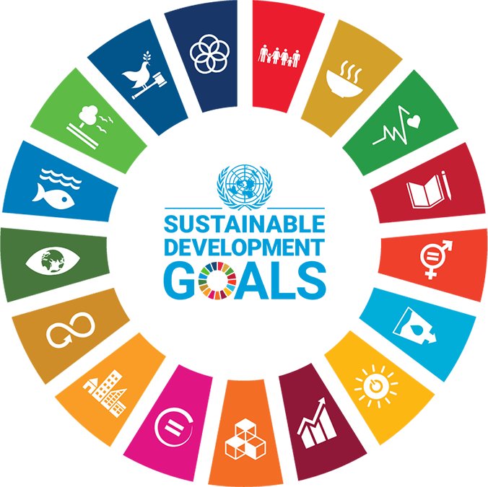



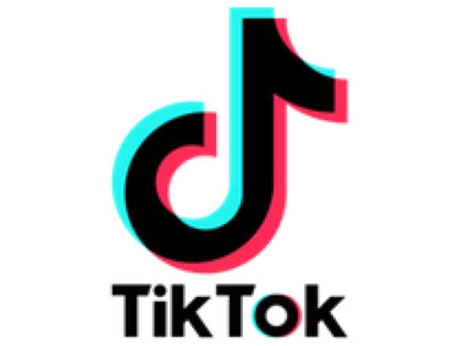


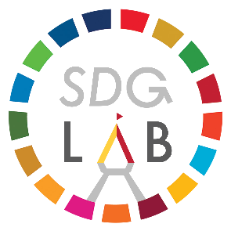
1. ALIGNMENT WITH SDG
PROJECT PURPOSE
2. DEVELOP FUTURE ENVIRONEMENTAL THOUGHT LEADER
Throughout the program, participants will be able to develop:
Understanding of the circular economy, including problems, solutions, and opportunities, and how different sectors respond to the concept in both general and ASEAN contexts.
Knowledge and tools for developing circular solutions that address sustainability issues and understanding how the concept could be implemented in various forms.
With a common mission and commitment to achieve the SDGs and create a sustainable future, the Circular Innovation Challenge has been developed through collaboration across various sectors.

Slide 5
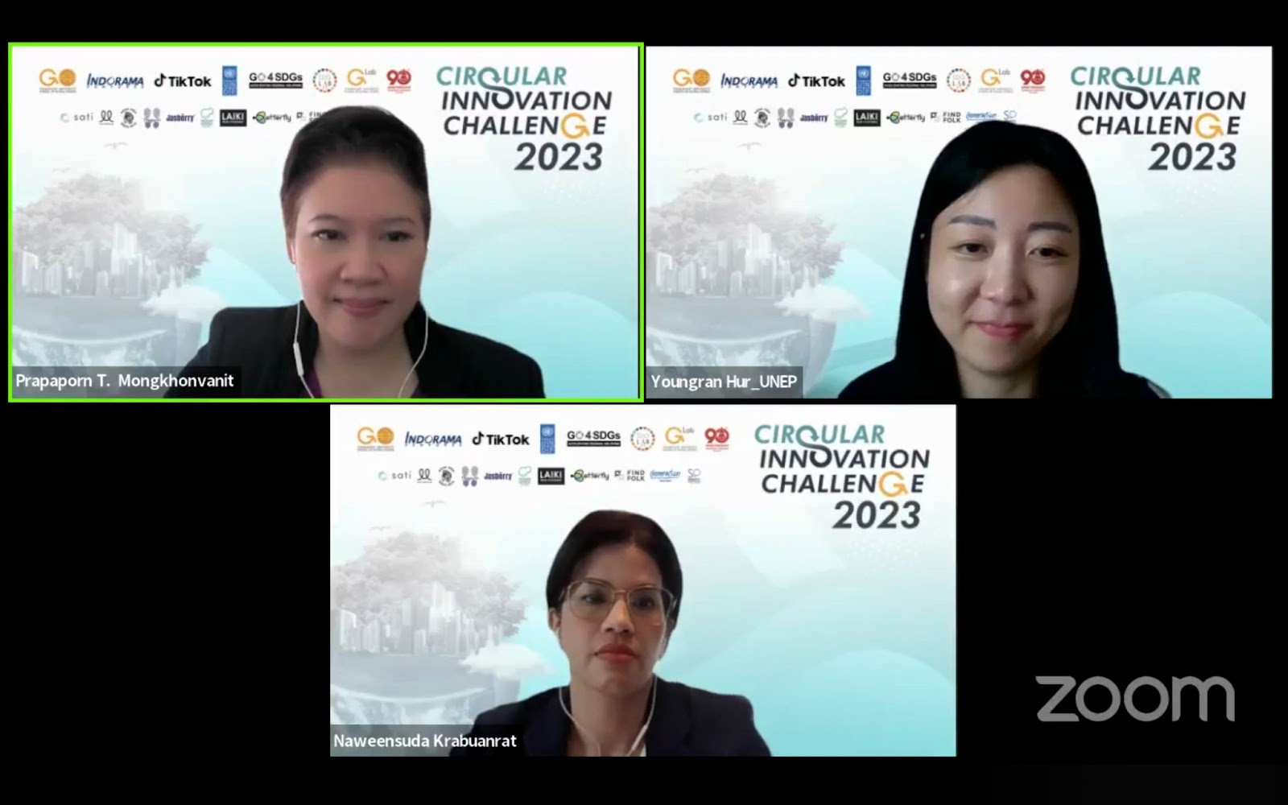
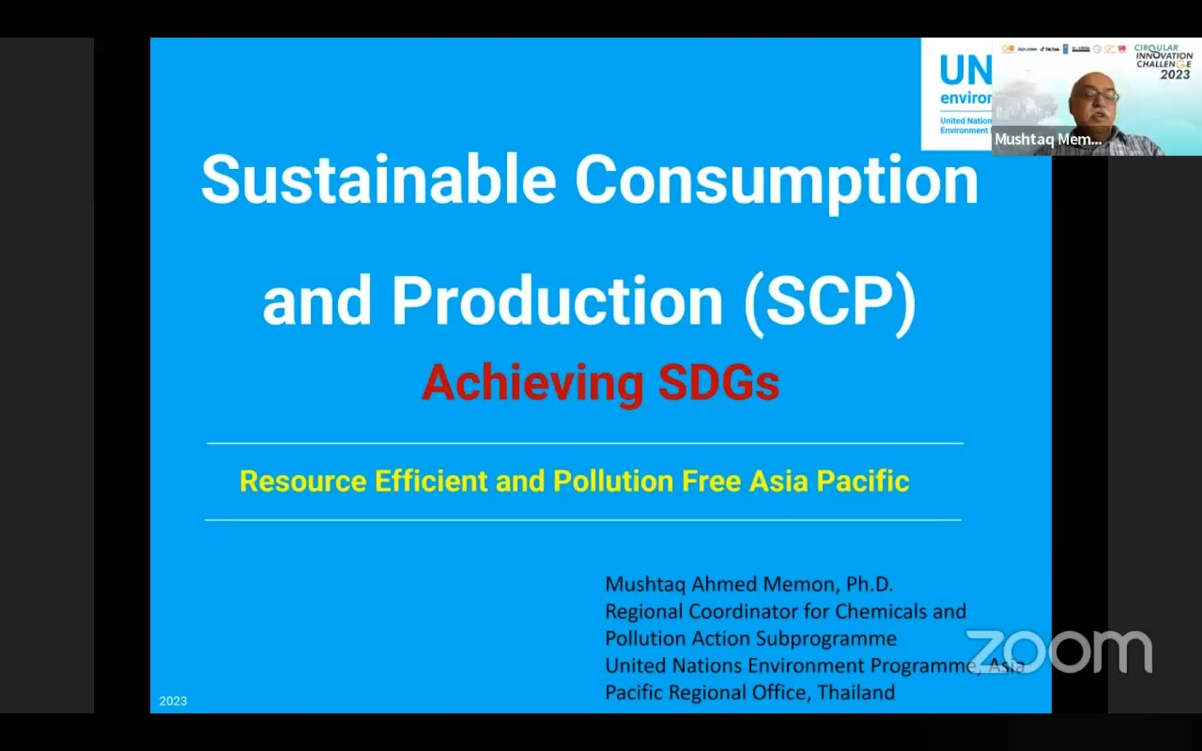
PROJECT PURPOSE
3. FACILITATE INTERNAITONAL EXPERIENCE FOR YOUNG INNOVATORS THROUGH ONLINE PLATFORM
To extend impacts across 11 countries in the Southeast Asia, the program has been developed via ONLINE platform. The program includes:
Online Panels
5-Weekend online workshops
3 Hr. online session with 10 mentors
Final Competition
“In total, 27-hour challenge across 5 weekends.”

Slide 6
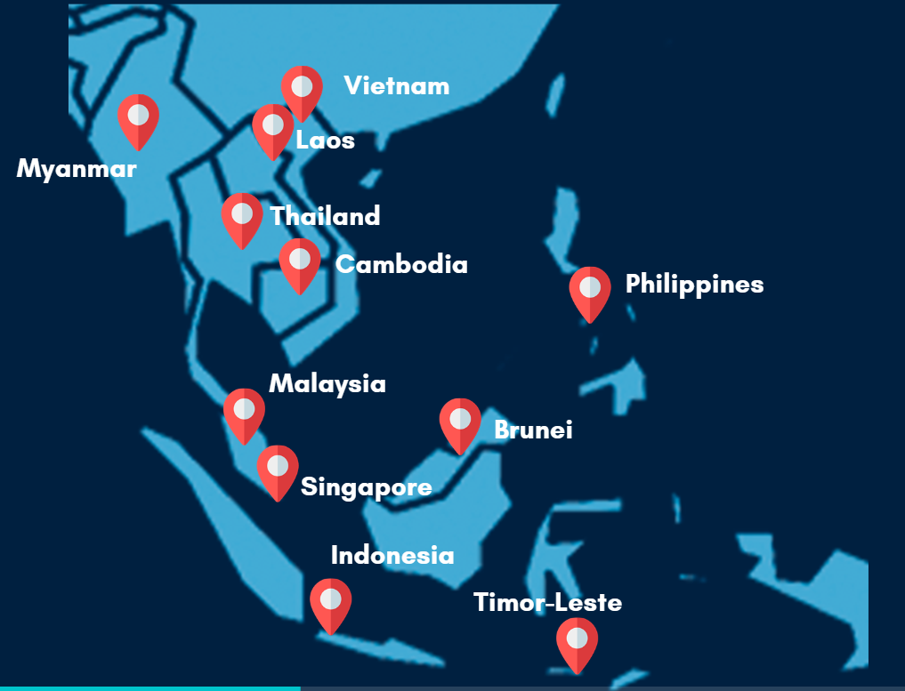
PARTICIPANTS
1. CRITERIA FOR PARTICIPANTS:
Teams of 3-5 members
Aged 16-30 years old
Open to participants from all 11 Southeast Asian countries: Brunei, Myanmar, Cambodia, Timor-Leste, Indonesia, Laos, Malaysia, the Philippines, Singapore, Thailand and Vietnam.
2. NUMBER OF PARTICIPANTS EACH YEAR:
2021: 174 TEAMS (700+ APPLICANTS)
2022: 469 TEAMS (1,932+ APPLICANTS)
2023: 830 TEAMS (3,333 APPLICANTS)

Slide 7
LEARNING POINTS
1. INCLUSIVITY AND EQUITY:
To develop an international learning program, some countries have more challenges due to language barrier.
To mitigate equity issues for non-English speaking teams of the Circular Innovation Challenge, at least one member of the team must have adequate English proficiency to facilitate understanding in their team.
2. STAGES OF INNOVATION:
Pre-Seed Stage
Seed Stage
Early Stage
Growth Stage
Expansion & Exit
The innovations of CIC participants are in the pre-seed and seed stages. They face the challenge of advancing their ideas to a higher stage, requiring additional support in terms of finance, mentorship, and policy backing. Commitment is also a concern, given that many of them are senior high school and university students who still need to remain engaged with their academic commitments.

Slide 8
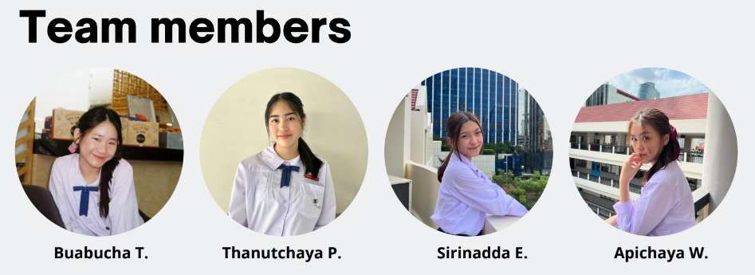
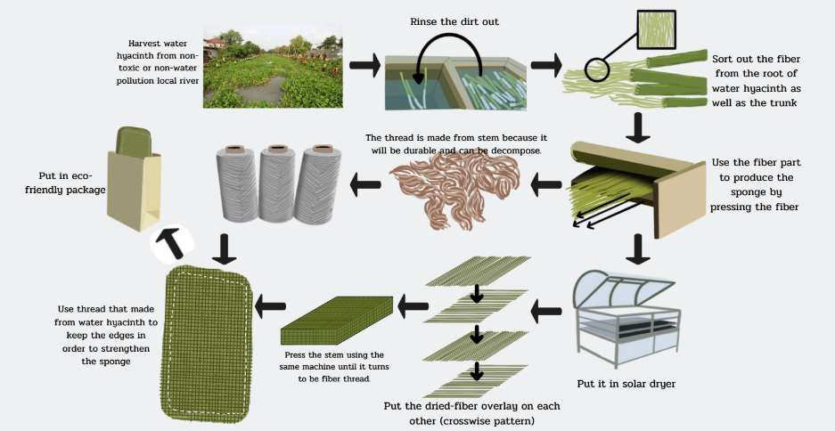
EXAMPLES OF INNOVATION OF THE WINNERS
CIRCULAR INNOVATION CHALLENGE 2022
1. TEAM:
4 high school students from Mater Dei School in Bangkok, Thailand
2. INNOVATION:
The Water Hyacinth Kitchen sponge aims to address the issue of excessive water hyacinth in canals and the widespread use of plastic sponges in households. It utilizes the cellulose content present in water hyacinth to create a sponge, as opposed to traditional polyester sponges made from plastic.

Slide 9
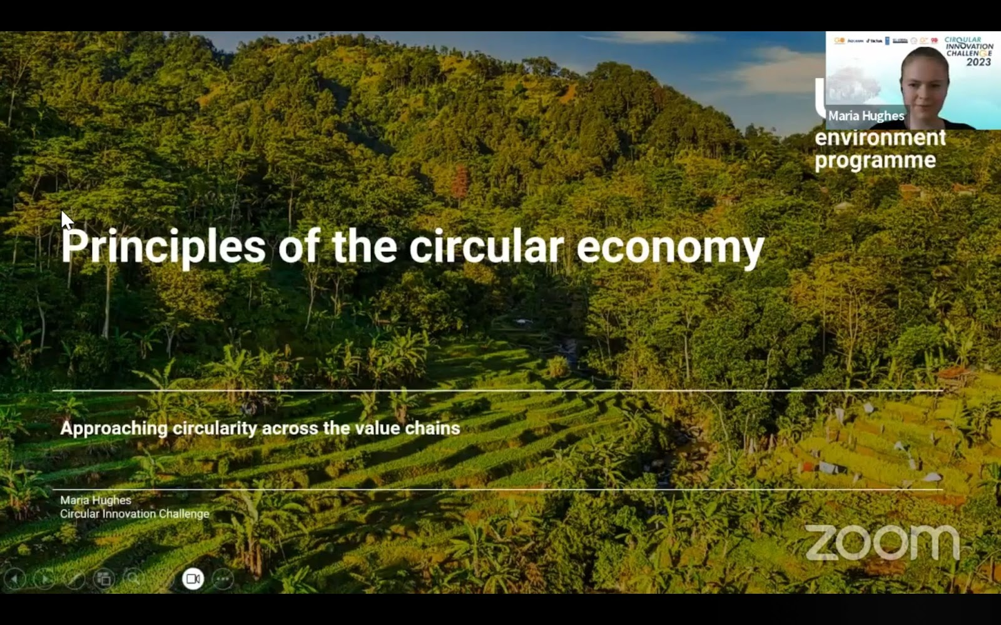
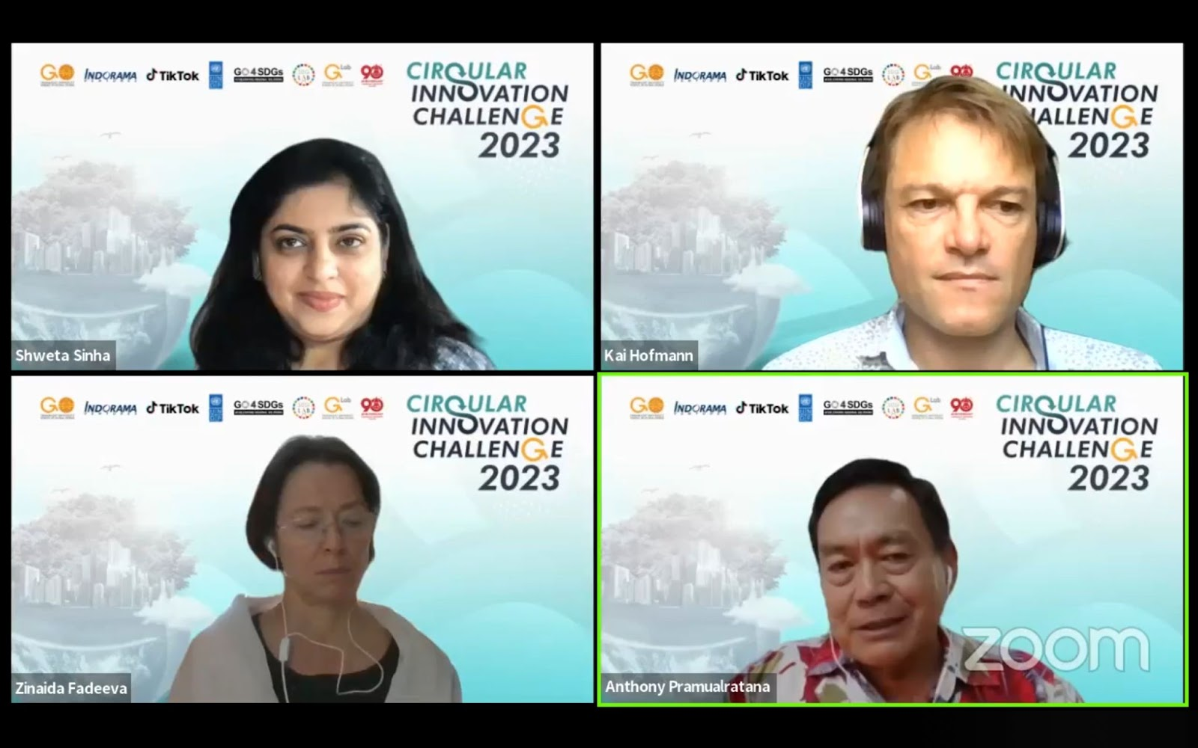
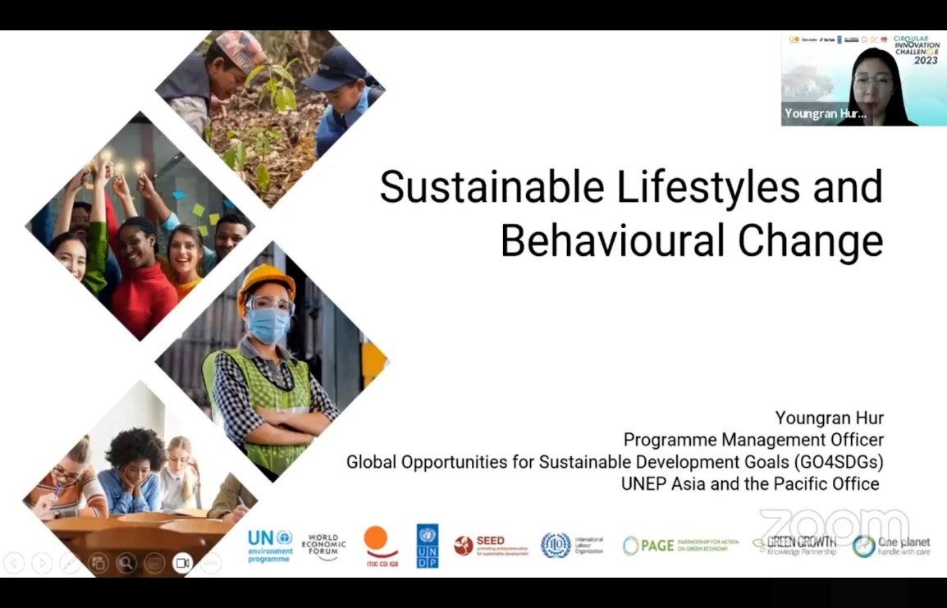
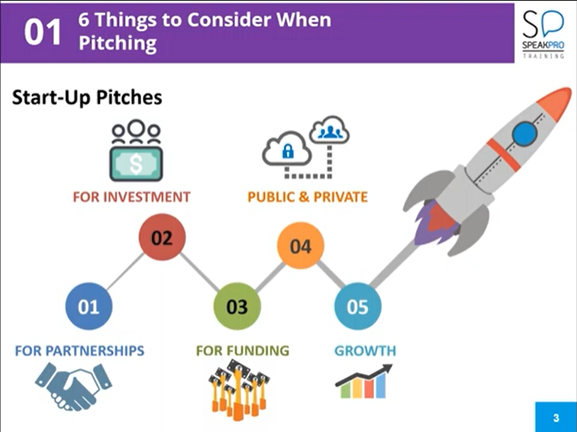
OUTCOMES & IMPACTS
1. Sustainable Literacy:
Raise public awareness about the SDGs and cultivate a sustainable mindset.
2. Circular Innovation Knowledge Set:
Generate new ideas, products, or processes that adhere to the principles of a circular economy.

Slide 10
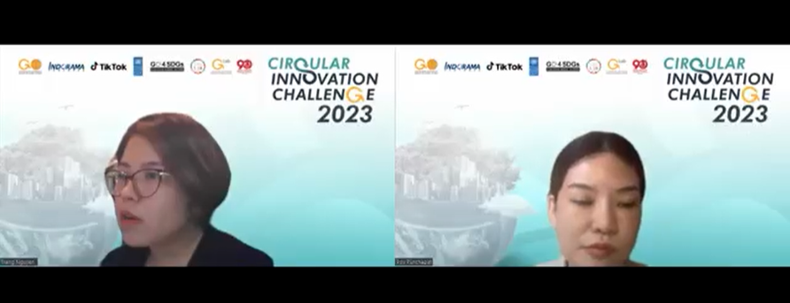
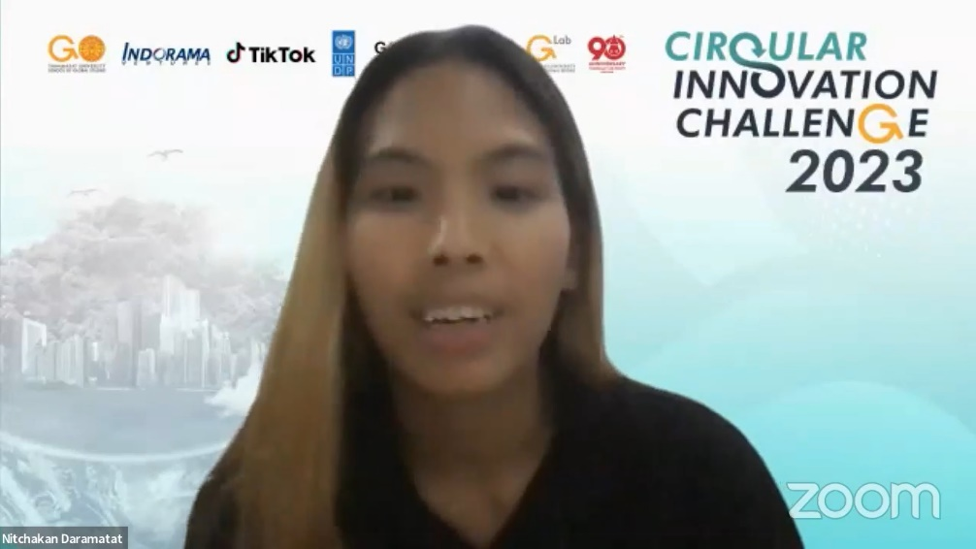

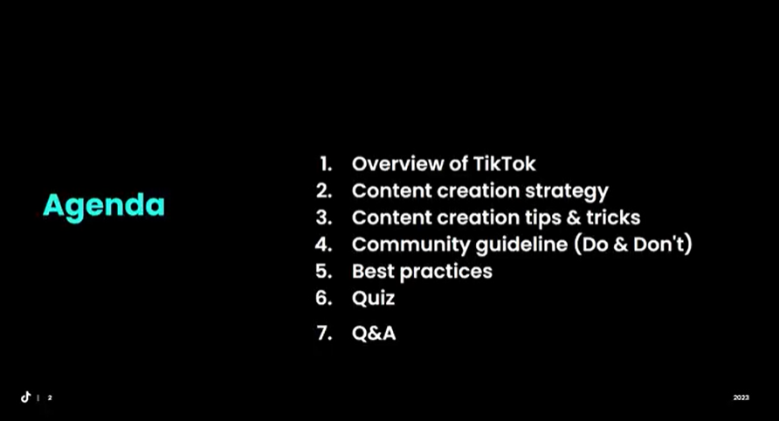
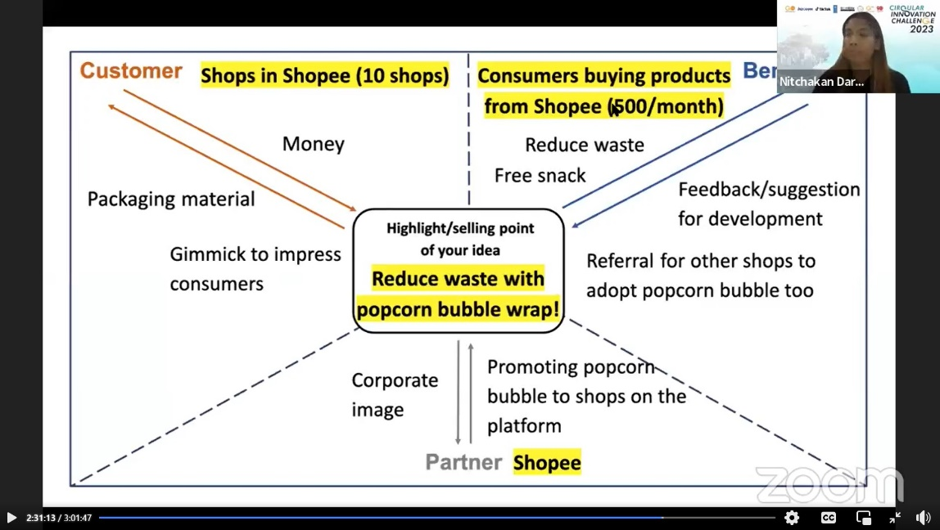
KNOWLEDGE PARTNERS
3-Hr Content Creation Workshop
Event Promotion on TikTok (TopView video)
6-Hr Circular Design Thinking Workshop
Finalists’ Idea Selection

Slide 11
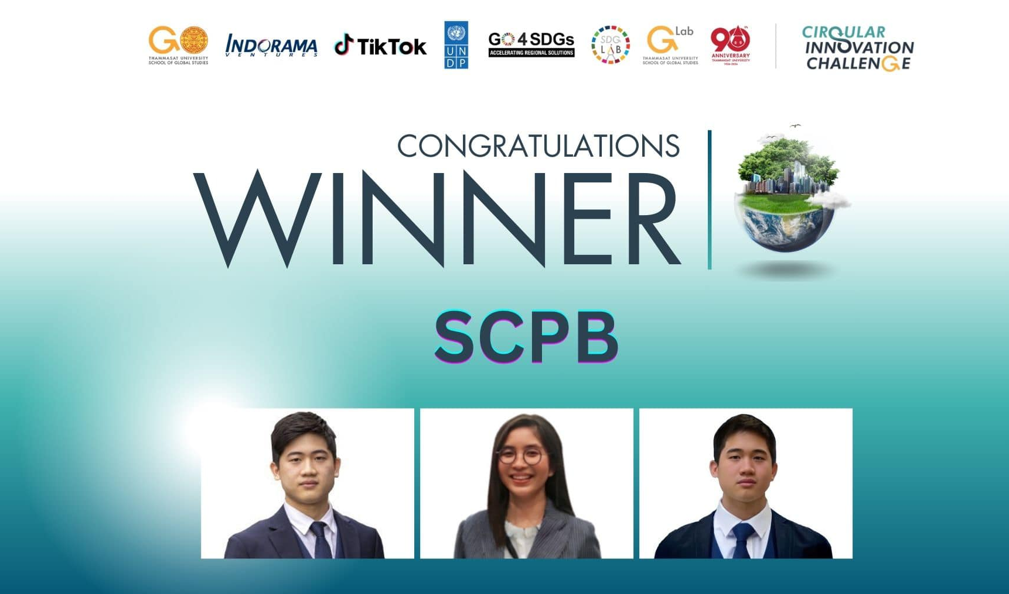
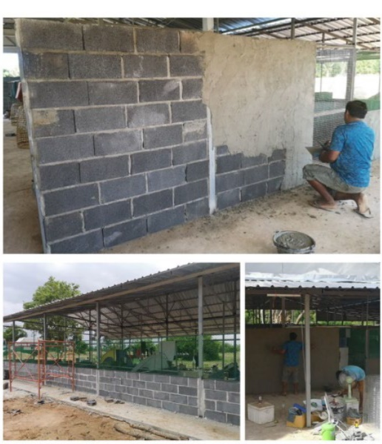
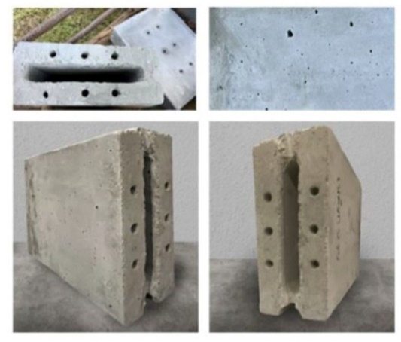
ALUMNI
Recent Winner (2023)
Phytavaren Technology is a proptech startup developing the Semi-Calcite Passive Brick by integrating waste materials into the construction industry, including shells, glass, and plastic, addressing the plastic pollution crisis while enhancing building thermal efficiency.
SGS is now helping the winner to develop their marketing campaign promote their innovations on different platforms: TikTok, FB, IG.

Slide 12
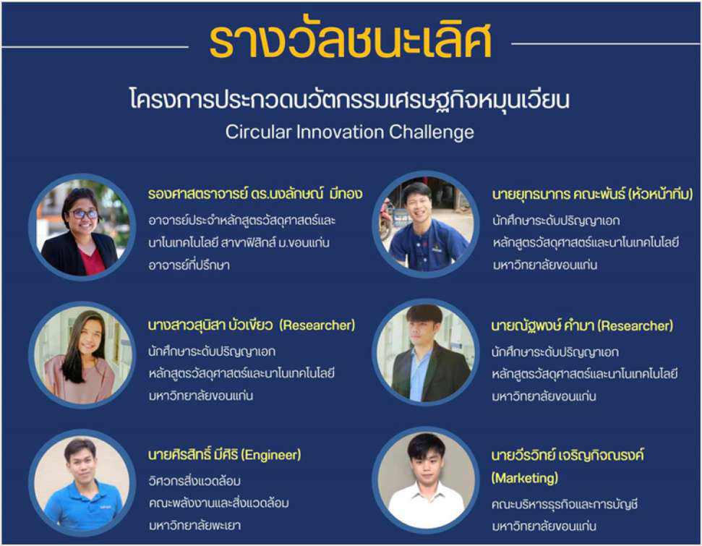
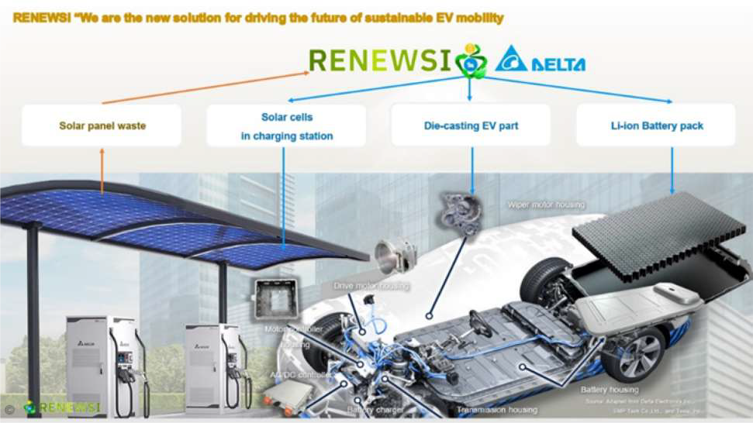
ALUMNI
Winner (2021)
Recyso introduced an innovation called Recycling Technology for Silicon Solar Cells, transforming Solar Panel Waste into Fast-Charging Batteries and High-Value Products. This solution is inspired by the current situation in Thailand, which currently lacks processes for repurposing old or unused solar cells into new ones or the production of other items, such as new batteries.
The winning team progressed by establishing RENEWSI startup with a recycling plant and is currently applying for an exclusive patent license.

Slide 13
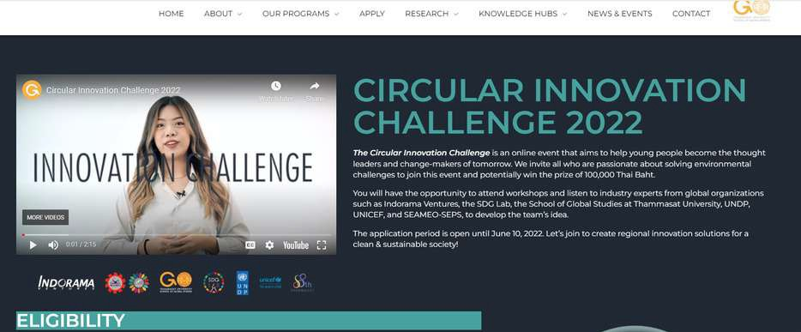



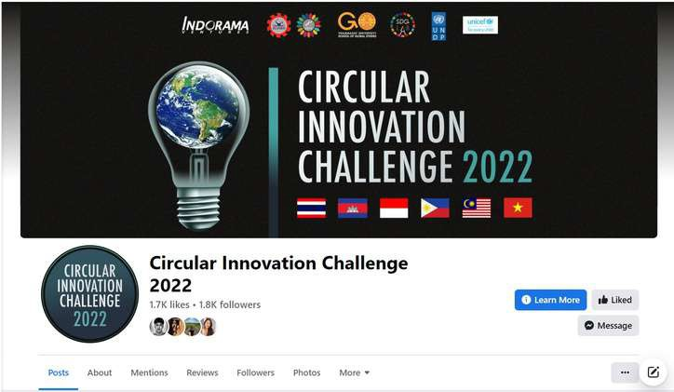
CONTACT
https://sgs.tu.ac.th/tucircularinnovation/
@tucircularinnovation
prapaporn@sgs.tu.ac.th
tucircularinnovation@sgs.tu.ac.th

